Slide 1

CONCEPTS OF PROGRAMMING LANGUAGES
12th Edition
Chapter 9
Subprograms

Slide 2
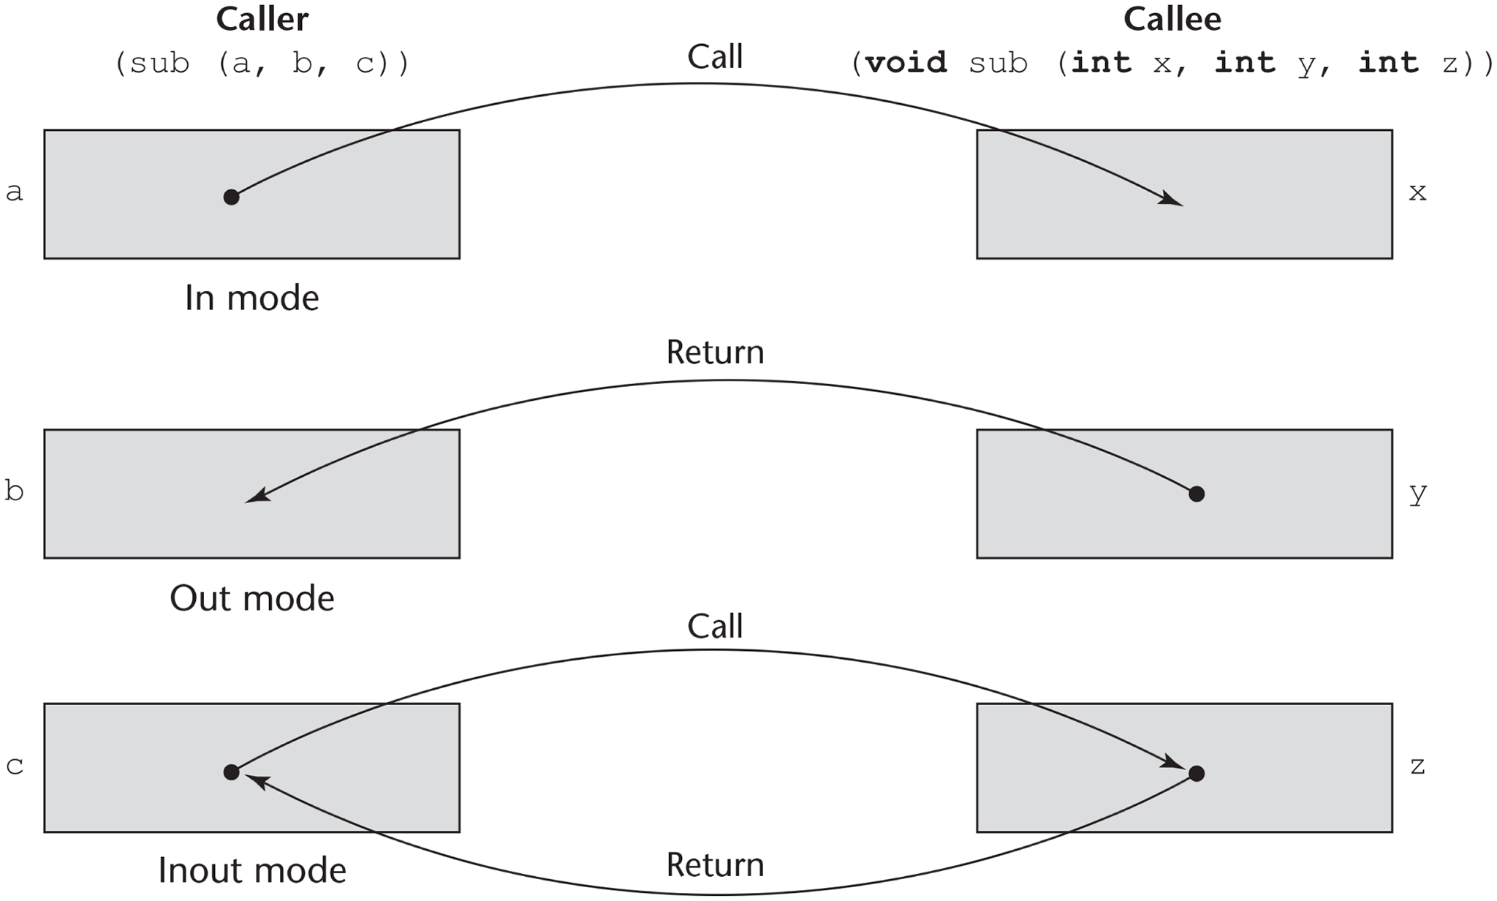
Figure 9-1 The three semantics models of parameter passing when physical moves are used

Slide 3
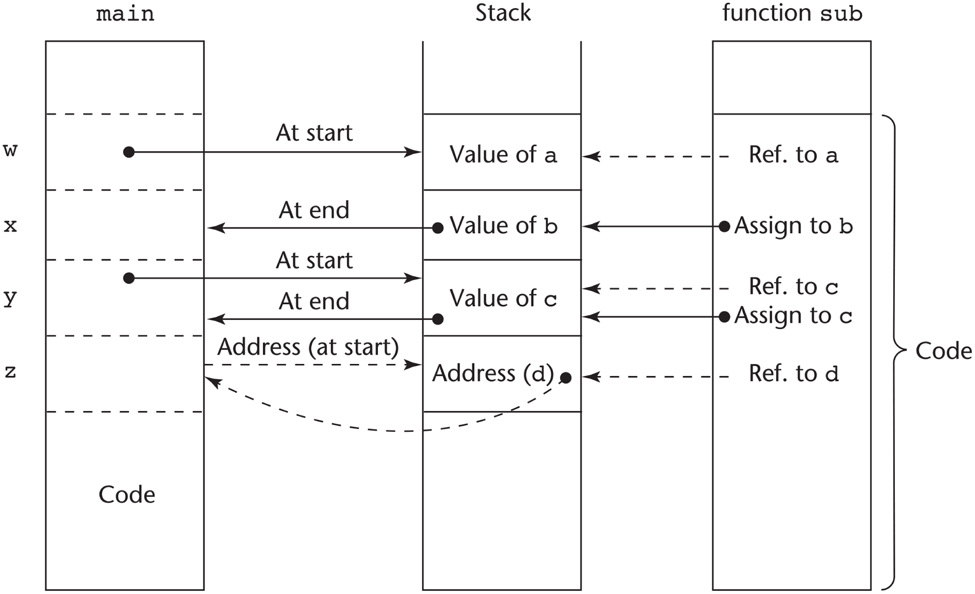
Figure 9-2 One possible stack implementation of the common parameter-passing methods

Slide 4
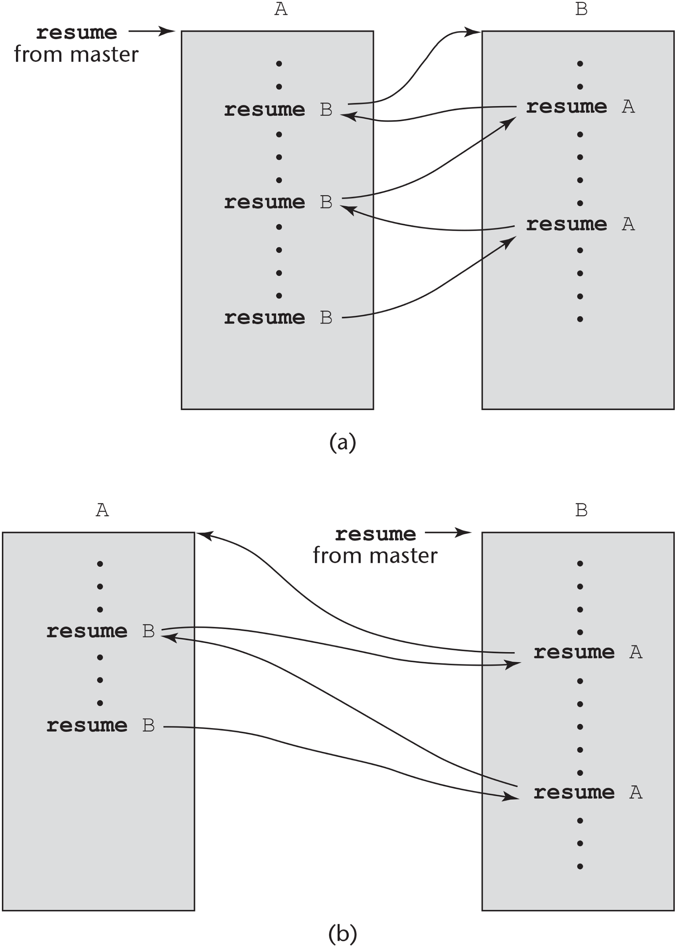
Figure 9-3 Two possible execution control sequences for two coroutines without loops

Slide 5
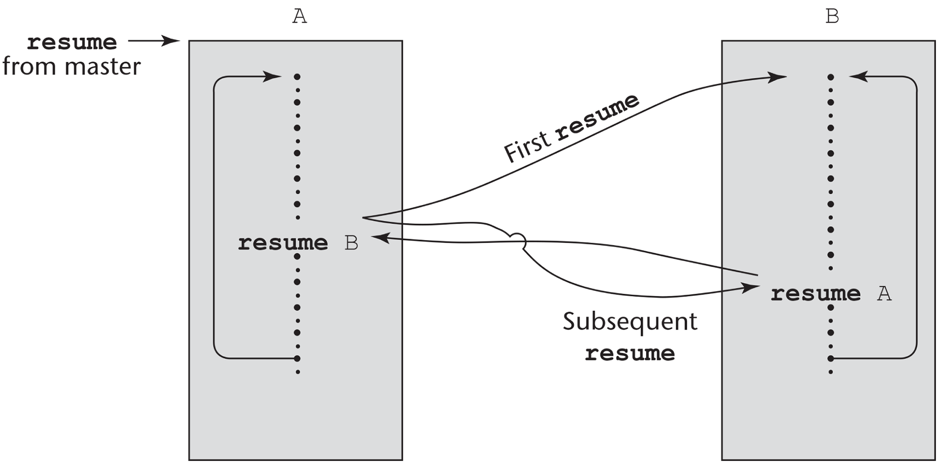
Figure 9-4 Coroutine execution sequence with loops

